Slide 1
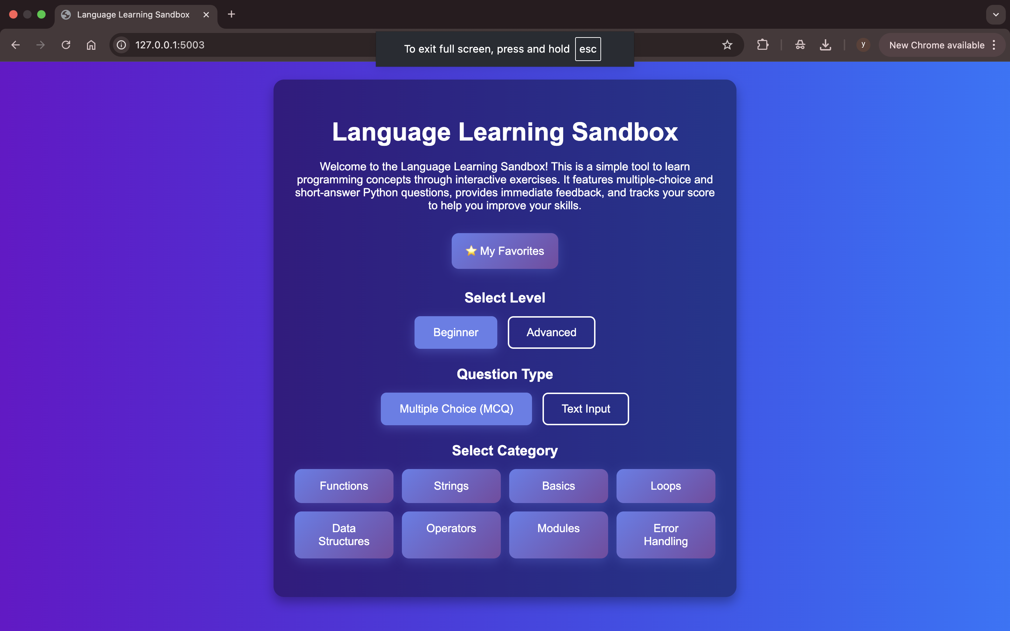
Language Sandbox
PyQuest
Aya khattab
Mayar Elmenisy
Yousra Okasha
Yassin Zakaria
Youssef Yasser
Youssef Ihab
Submiited to DR.Mohamd Khalaf
Course: Structure of programming

Slide 2
Agenda
Problem
Target
What the System Does
Why This Matters
How Questions Are Processed
Breaking Down the Checking Step

Slide 3




Problem
Lack of Interactive Practice
Difficulty with Syntax and Logic Errors
Manual checking takes time
Learners need instant feedback

Slide 4
Target
“Because Learning Code Shouldn’t Hurt.”
Reinforce Core Python Concepts
Implement micro-learning
Give helpful hints when they struggle
Explain mistakes so the user learns
Build confidence through guided practice.

Slide 5



What the System Does
Question progression
score
User responses VS. Correct answers
Loads Topic-Based Questions
Manages User Game Flow
Validates User Answers
Provides Instant Feedback

Slide 6
Why This Matters
Check meaning
Support learning
Check syntax
Give hints

Slide 7
How Questions Are Processed
Load
  load all questions from a JSON-like Python list
Filter
  filter questions by level and category
Send
  send a random order to the frontend
Accept
  accept the user’s input
Analyze
  analyze the text
Check
  check the meaning
Compare
  compare with expected answer
Return
  return correctness and explanation

Slide 8
Breaking Down the Checking Step
Every answer passes through two layers.
1.grammar
2.meaning
Grammar looks at
spelling
capitalization
word order
missing words
Meaning checks if
the core idea matches
keywords appear
the sentence fits the question
the answer expresses the same intention

Slide 9
File Structure
app.py is the backend (THE BRAIN)
questions.py stores all questions
script.js runs quiz logic
style.css manages design
index.html is the landing page
quiz.html runs the quiz
results.html shows the score
favorite.html show favorite question
Every file has a specific job and links through Flask routes or JavaScript requests

Slide 10

Backend Used
project uses Flask to handle:
routing
serving HTML templates
sending questions to the frontend
receiving answers from the frontend
comparing user answers
returning scores and explanations
storing session data

Slide 11
Backend Workflow
The backend handles three things.
load all questions
respond to user actions
Routes
“/get_questions” returns filtered questions
“/submit_answer” checks correctness
“/results” sends the final score
The backend forms the connection between data and UI.

Slide 12
Frontend Workflow
The frontend handles interaction and display.
JavaScript
fetches questions
updates the screen
submits answers
shows hints
shows feedback
sends final result to backend
HTML shows the interface
CSS gives the layout
JavaScript makes it dynamic

Slide 13
Why This System Matters
The system improves learning
users practice writing instead of guessing
they receive explanations
they develop real understanding
they learn from mistakes
the system adapts to level and category
It supports language learning in a measurable way.

Slide 14
Thank You

